Slide 1
The Adventurous Project of building a processor
By Nate Doher, molly lee, & Shea winkler

Slide 2
Objectives
The
Processor that could Implement a
Goal of Our
Project was to Create a
Subset of the NIOS II Architecture and Some
Features Unique to ARM-Like Conditional Executions

Slide 3
outline
Our project was broken up into 6 phases, each of which was vital to the success of the project.
Phase 1: Register File, ALU, & Control Unit
Phase 2: Data Path & R-Type Instructions
Phase 3: Remaining Instructions: R-type, D-type, B-type
Phase 4: I/O & ARM-like Conditional Execution
Phase 5: Bonus: More I/O & J-type Instructions
Phase 6: Design Doc, Presentation, Demo
Phase 7: Bonus: Assembler

Slide 4
Phase 1: what we tried to accomplish

Slide 5
Phase 1: what we actually did

Slide 6
Phase 1: difficulties that arose

Slide 7
Phase 2: what we tried to accomplish

Slide 8
Phase 2: what we actually did

Slide 9
Phase 2: difficulties that arose

Slide 10
Phase 3: what we tried to accomplish

Slide 11
Phase 3: what we actually did

Slide 12
Phase 3: difficulties that arose

Slide 13
Phase 4: what we tried to accomplish

Slide 14
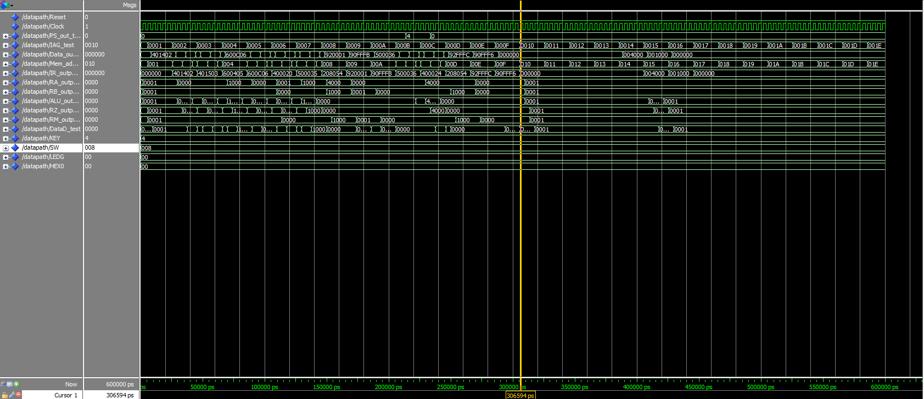
Phase 4: what we Submitted (20 Nov. 2017)
No Branch!
No
Branch-and-Link!
Bitmap Submitted

Slide 15
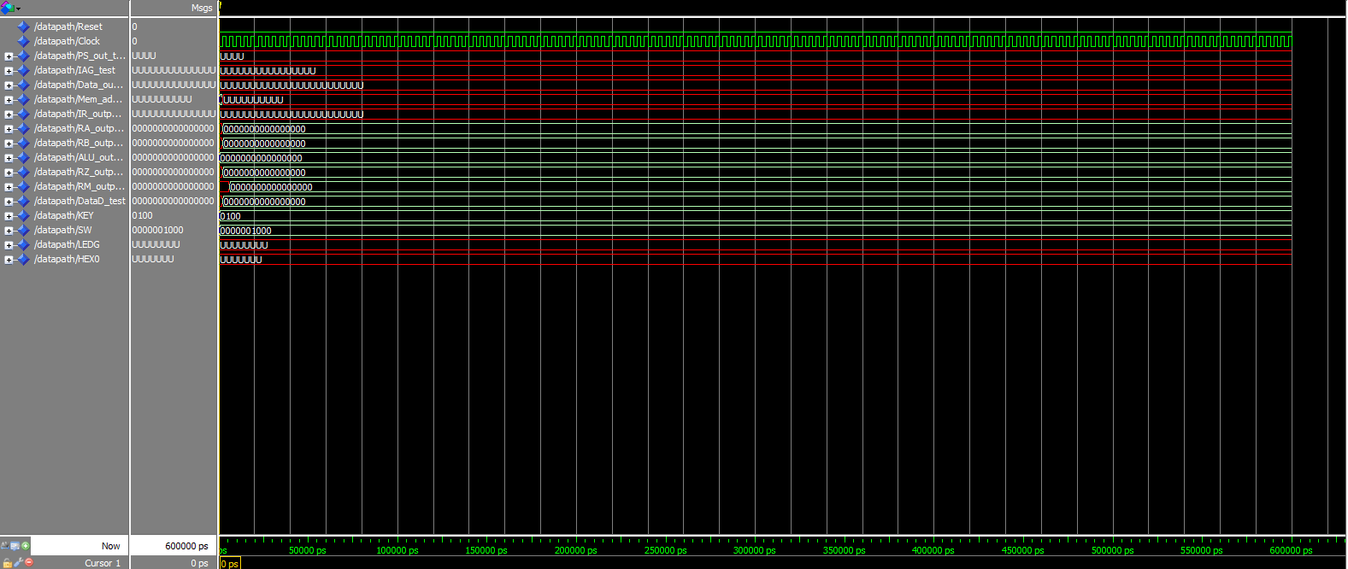
Phase 4: difficulties that arose

Slide 16
Phase 5: what we tried to accomplish

Slide 17
Phase 5: what we actually did

Slide 18
Phase 5: difficulties that arose

Slide 19
Phase 6: what we tried to accomplish

Slide 20
Phase 6: what we actually did

Slide 21
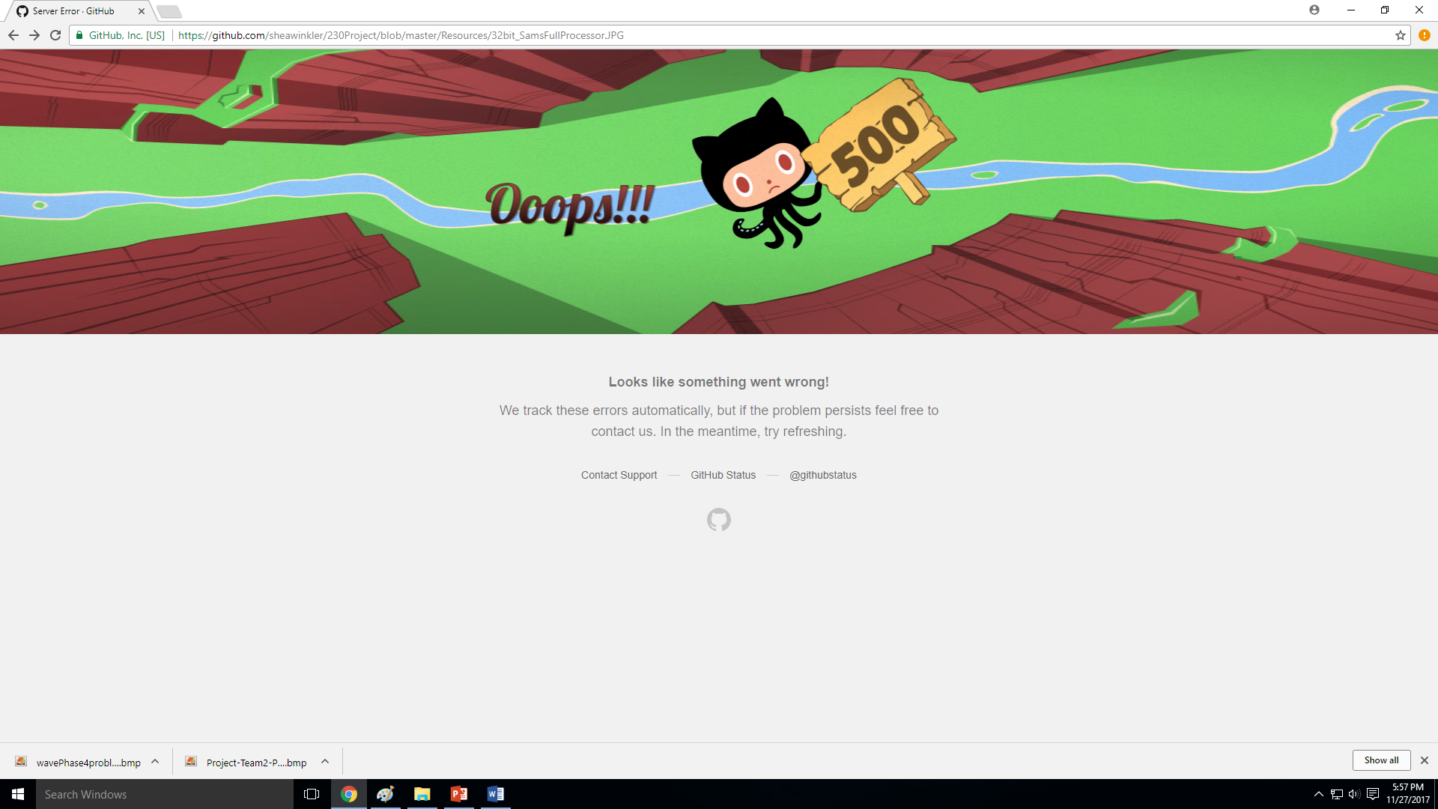
Phase 6: difficulties that arose

Slide 22
Final result

Slide 23
summary

Slide 24
SUMMARY
The goal of our project was to create a processor that could implement a subset of the NIOS II Architecture and some features unique to ARM.
In Phase 1, we created the Register File, ALU, & Control Unit.
In Phase 2, we implemented the Data Path & R-Type Instructions.
In Phase 3, we implemented the remaining R-type, D-type, B-type instructions.
In Phase 4, we implemented I/O & ARM-like Conditional Execution.
In Phase 5, we had the option to do more I/O & J-type Instructions.
In Phase 6, we created the Final Design Doc, Presentation, & Demo.
In Phase 7, we created an Assembler for Bonus Points.

Slide 25
conclusion

Slide 26
References

Slide 27
We would like to thank:
Aaron Johnson
Quinn Lanik
Jianfei Shao
Matt Bennett
Samuel Hansen
Tyler Bienhoff
Dr. Riedesel
Michael Fay

Slide 28
Questions?

